Slide 1

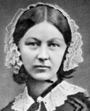
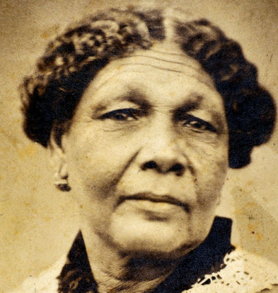
Knowledge Organiser – People of the World
Year 2 – Nurses in History
Who was Florence Nightingale?
Vocabulary
nurse | A person trained to care for sick people, especially in a hospital.
injured | Someone who is harmed, damaged, or impaired.
Crimea | A peninsula in Eastern Europe where Britain, France and Turkey fought Russia during the Crimean War.
soldier | A person who serves in an army.
medal | A metal disc given to a person as an award.
war | The act of fighting between two countries or groups of countries.
Jamaica | An island in the West Indies.
hygiene | Keeping yourself and your surrounding clean in order to prevent illness and disease.
hospital | A place where you can get medical help from people such as surgeons, doctors and nurses.
Who was Mary Seacole?
A nurse who greatly reduced deaths by improving hygiene and living standards.
A nurse who set up a hotel to care for sick officers, using good food, hygiene and traditional medicine during the Crimean war.
What other names was Florence Nightingale known by? The Lady with the Lamp
What other name was Mary Seacole known by? Mother Seacole
Significant Events:
Born 12th May 1820 in Florence, Italy.
Became a nurse in 1851.
She travelled to Turkey to help sick soldiers.
She introduced hygiene, clean linen and good food, saving soldiers lived.
Returned to London at the end of the Crimean war.
Queen Victoria gave her a medal and money which she used to open a School for Nursing.
Her standards for nursing are still used today.
Significant Events:
Born 23rd November 1805 in Jamaica.
Learnt her nursing skills from her mother.
Travelled to London to volunteer to help but was refused due to her skin colour.
Travelled to Crimea and treated soldiers on the battlefield.
Opened her own hotel to treat injured officers.
Used traditional medicines with a good diet and hygiene.
Died 14th May 1881 in London, aged 76 years old.
Related previous knowledge: Explorers & Inventors
Related future learning: Medicines and Diseases

