Slide 1

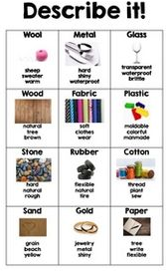
Knowledge Organiser
WHAT I SHOULD ALREADY KNOW
DIAGRAMS
KEY VOCABULARY
I can identify a variety of objects and the material it is made from.
I can name a some everyday materials such as wood, plastic, glass and metal.
I can describe some of the properties of everyday materials.
Key Word | Definition
Property | A characteristic of a material e.g. hard, soft, flexible.
Absorbent | Soaks up liquid easily.
Transparent | Able to see through.
Translucent | Let light through but not transparent.
Opaque | Not able to see through.
Rigid | Unable to bend or be forced out of shape.
Flexible | Easy to change shape without breaking.
Waterproof | Liquid is unable to pass through the material.
Natural | When a material is used at its raw state.
Manufactured | When a raw material is made into a new one e.g. wood into paper.
Changing material | To alter the appearance of a material e.g. Squash, bend, freeze, heat, melt, twist.
WHAT I WILL KNOW BY THE END OF THE TOPIC
I will able to identify and differentiate between an object and material.
I will be able to describe the properties of a variety of everyday materials using a range of key vocabulary.
I will be able to identify materials and explain which one is best suited for specific purposes.
Scientific skills
To ask questions, set up a test using previous knowledge of materials, perform tests, to present findings.
Future Learning: Forces & Magnets in Year 3

